Slide 1
Hutchinson Gas Service Company
Group 6
-Sijia Lu
-Wenting Hu
-Heng Wang
-Qin Wang
-Duyen Thanh
-Xiangnan Cui
- Sujeet Buddiga

Slide 2
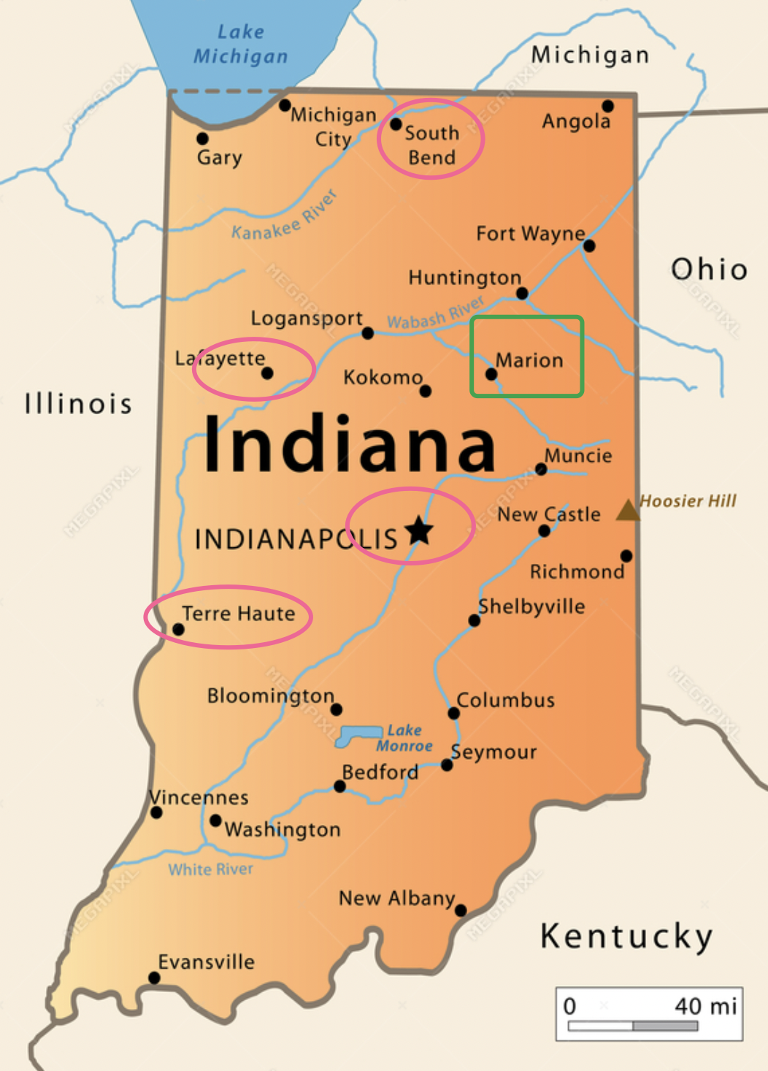
Introduction
Produce inert and chemically pure gases
fills special high pressure tanks with these gases
delivers the tanks to the customer on a weekly basis
collects the empty tanks for processing and refilling at the firm’s tank servicing facilities
Currently: There are 4 hubs with tank servicing facilities located in
Indianapolis, Lafayette, South Bend, and Terre Haute.
serves 12 customers.
Objective:
Perform analysis to decide whether to develop Marion and to close one or more of the existing facilities
Recommend the most cost effective 5-year strategic plan.

Slide 3
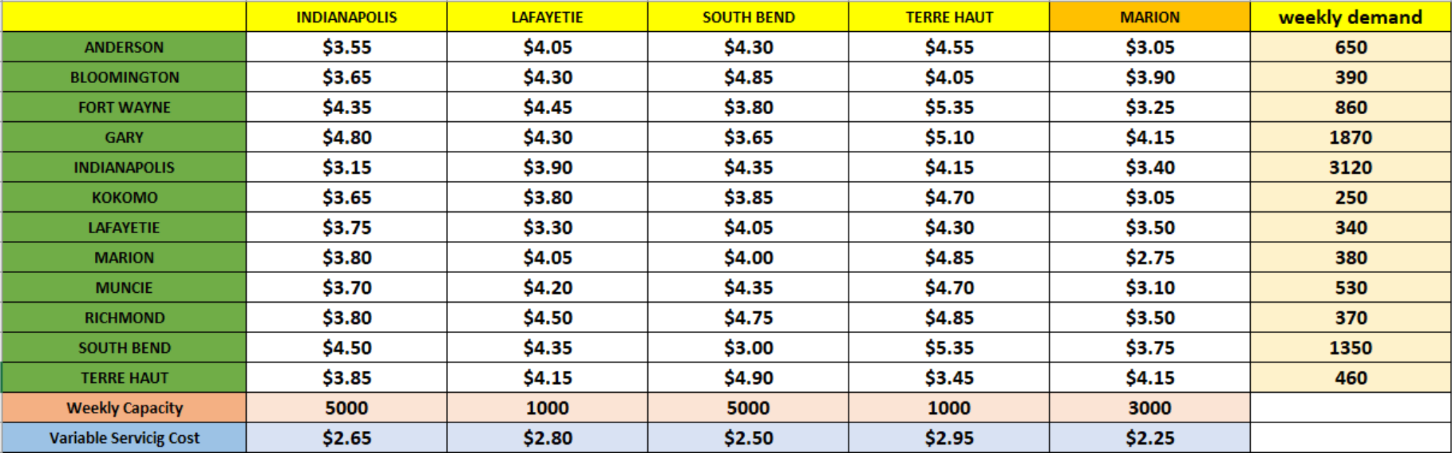
Factors
Total weekly demand = 10570 Tanks
Total Max supply = 15000 Tanks
Different Supply Costs across different Hubs to different destinations
Different Servicing costs across different Hubs
Cost of Purchasing new facility at Marion= $478,000.
Max Capacity of new facility at Marion = 3000 tanks per week.
Current Market Values of Different Hubs are Indianapolis $500,000, Lafayette $280,000, South Bend, $600,000, Terre Haute $250,000

Slide 4
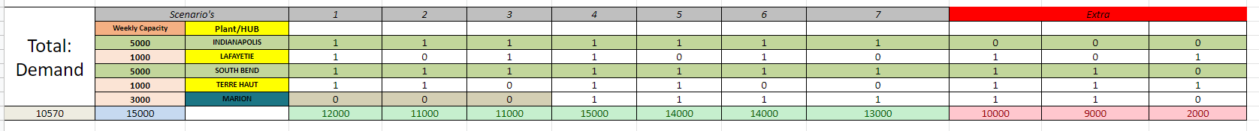
Inputs, Possible Combinations
We can clearly see that Indianapolis and South bend are necessary to achieve a demand of 10570 with supply capacities of 5000, 5000 respectively
Hence we are left with 7 unique scenario's
There are a total of 7 scenarios:
Scenario 1: all hubs are open, and Marion is not open.
Scenario 2: all hubs are open except Lafayette, and Marion is not open.
Scenario 3: all hubs are open except Terre Haute, and Marion is not open.
Scenario 4: all hubs are open, and Marion is open.
Scenario 5: all hubs are open except Lafayette, and Marion is open.
Scenario 6: all hubs are open except Terre Haute, and Marion is open.
Scenario 7: all hubs are open except Terre Haute and Lafayette, and Marion is open.

Slide 5
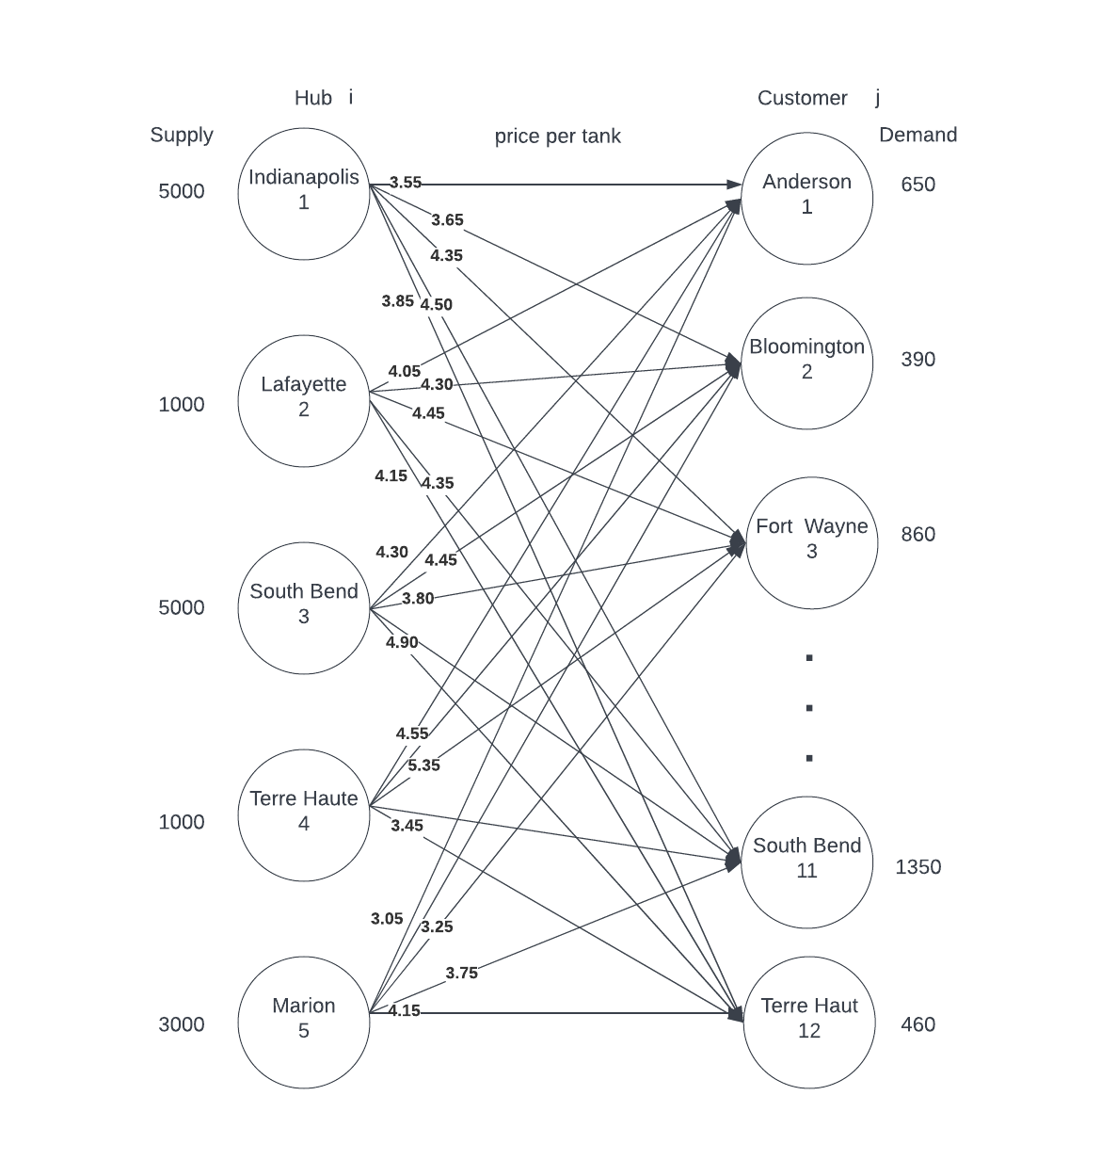
Algebraic Formulation
Notation:
Plant/Hub: 1 for Indianapolis, 2 for Lafayette, 3 for South Bend, 4 for Terre Haute, 5 for Marion. i = 1, 2, 3, 4, 5
Customer City: same as above, 12 cities, j = 1, 2, 3 … 12
Xi,j = the # of tanks delivered from hub i to destination city j
Decision variables:
Min weekly total cost = transportation costs + service costs
Transportation costs = 3.55X1,1 + 3.65X1,2 + ...+ 3.85X1,12
+ 4.05X2,1+ 4.30X2,2 + … + 4.15X2,12
+ 4.30X3,1 + 4.85X3,2 + … + 4.90X3,12
+4.55X4,1 + 4.05X4,2 + … + 3.45X4,12
+ 3.05X5,1 + 3.90X5,2 + … + 4.15X5,12
Service costs = 2.65∑X1,j + 2.8∑X2,j + 2.5∑X3,j + 2.95∑X4,j +2.25∑X5,j

Slide 6
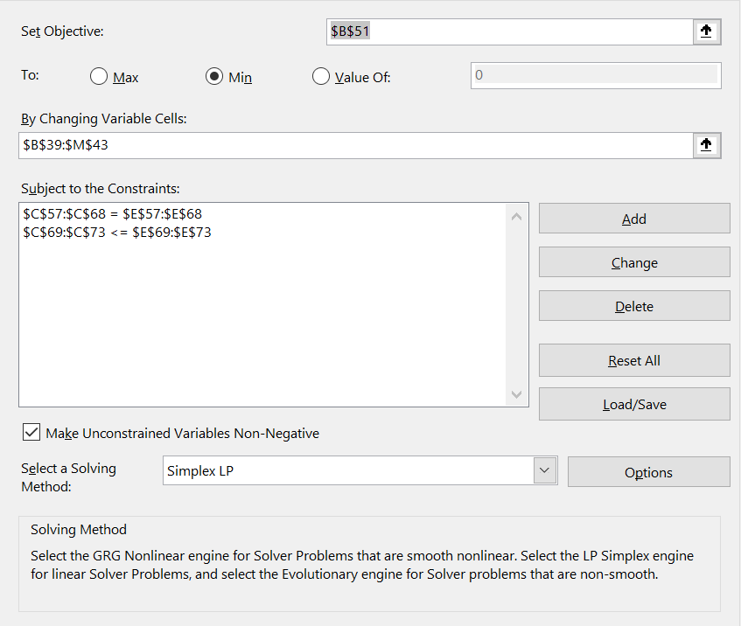
Defining the Constraints
Weekly Demand/Expected Supply:
∑Xi,1 = 650 } Anderson
∑Xi,2 = 390 } Bloomington
∑Xi,3 = 860 } Fort Wayne
… …
∑Xi,10 = 370 } Richmond
∑Xi,11 = 1350 } South Bend
∑Xi,12 = 460 } Terre Haute
Max weekly supply per hub:
In general: ∑X1,j ≤ 5000 } Indianapolis
∑X2,j ≤ 1000 } Lafayette
∑X3,j ≤ 5000 } South Bend
∑X4,j ≤ 1000 } Terre Haute
∑X5,j ≤ 3000 } Marion
In the future scenarios analysis, for the hub which is not open, the supply constraints will be 0.
Nonnegativity conditions: Xi,j ≥ 0 for all i and j

Slide 7
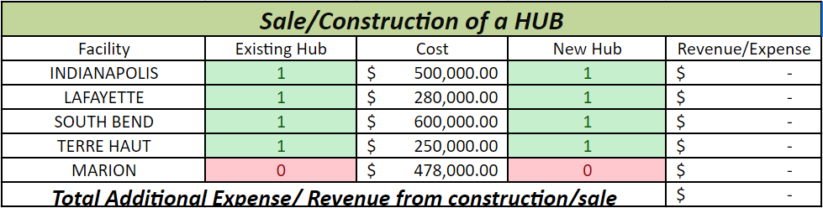
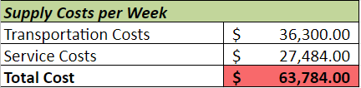
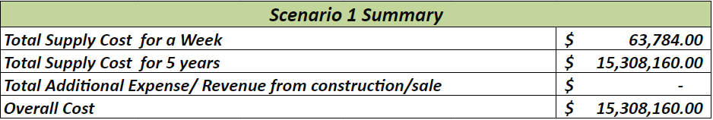
Scenario
1
all hubs are open, Marion is not open
63,784 * 4 * 12 * 5

Slide 8
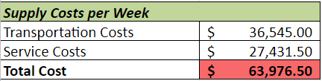
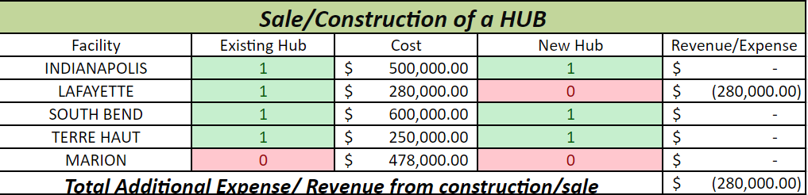
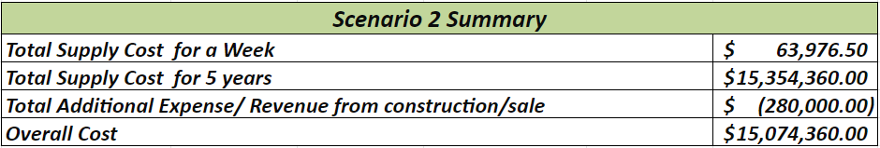
Scenario
2
all hubs are open except Lafayette
Marion is not open

Slide 9
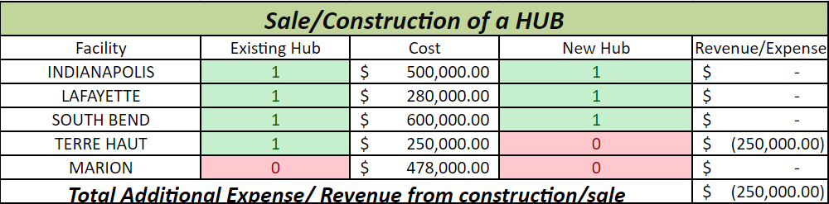
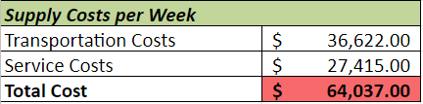
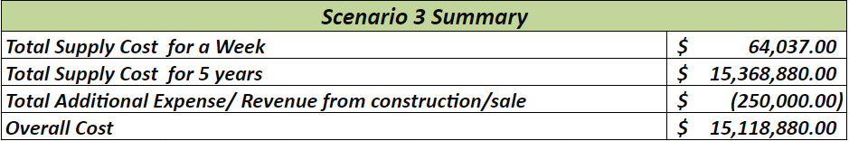
Scenario
3
all hubs are open, except Terre Haute
Marion is not open

Slide 10
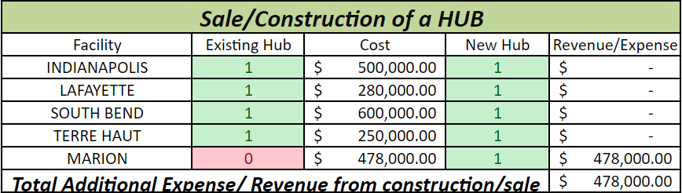
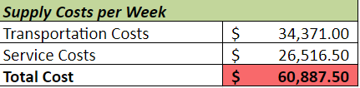
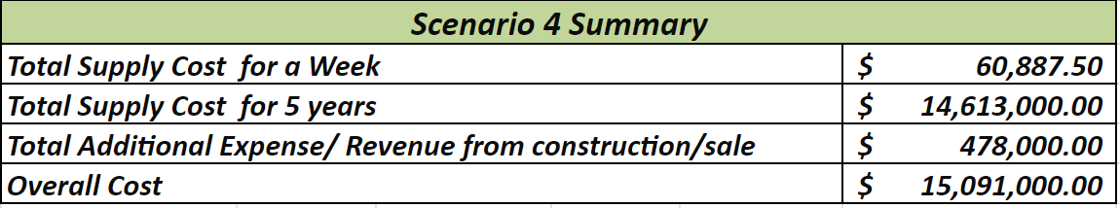
Scenario
4
all hubs are open,
Marion is open

Slide 11
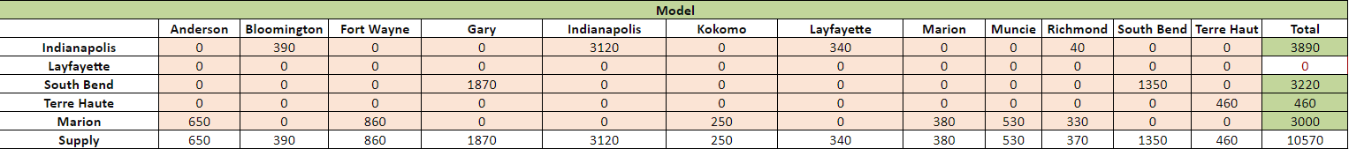
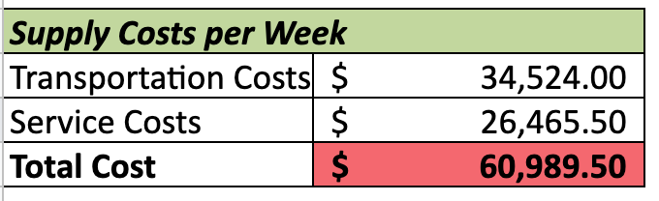
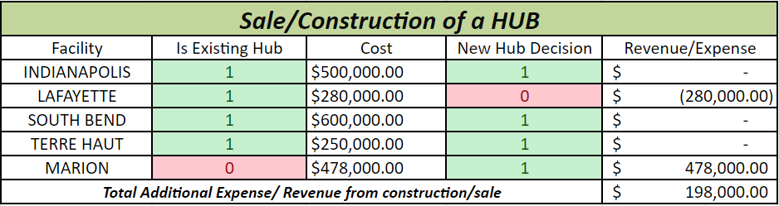
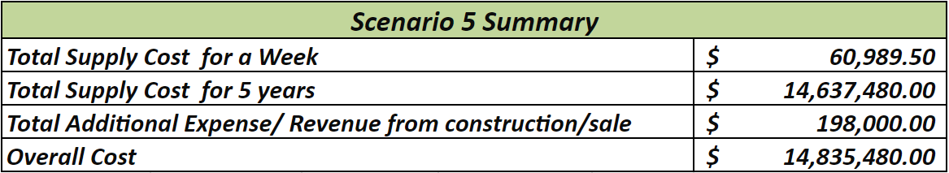
Scenario
5
all hubs are open except Lafayette
Marion is open

Slide 12
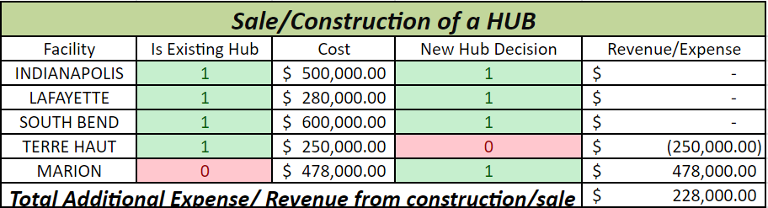
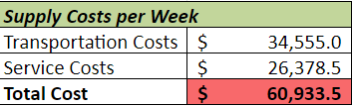
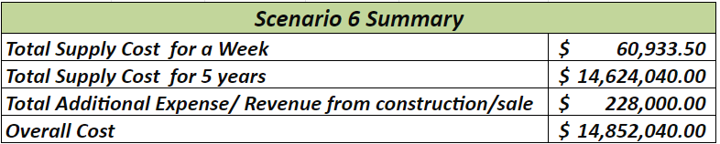
Scenario
6
all hubs are open except Terre Haute
Marion is open

Slide 13
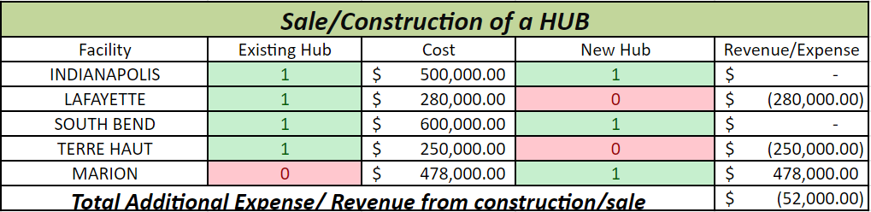
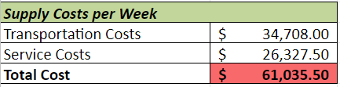
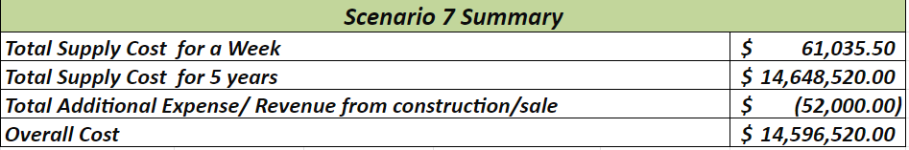
Scenario
7
all hubs are open except Terre Haute and Lafayette, Marion is open

Slide 14
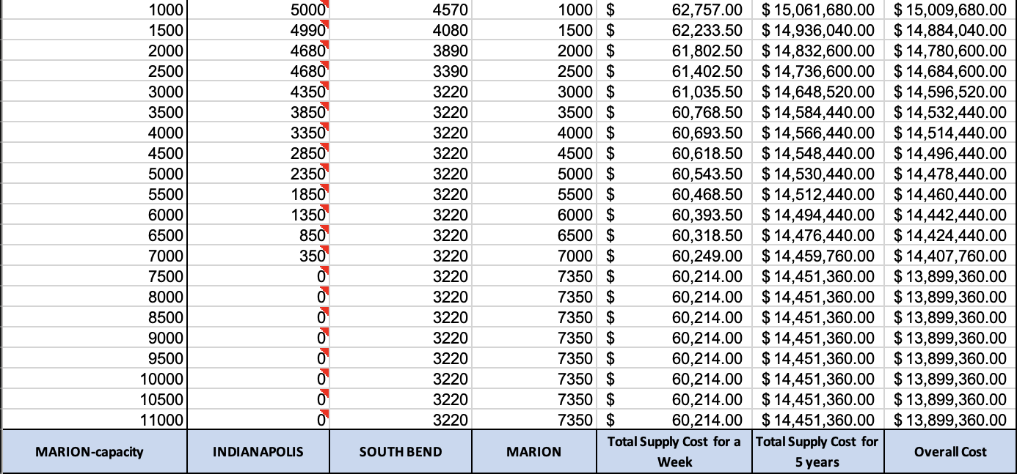
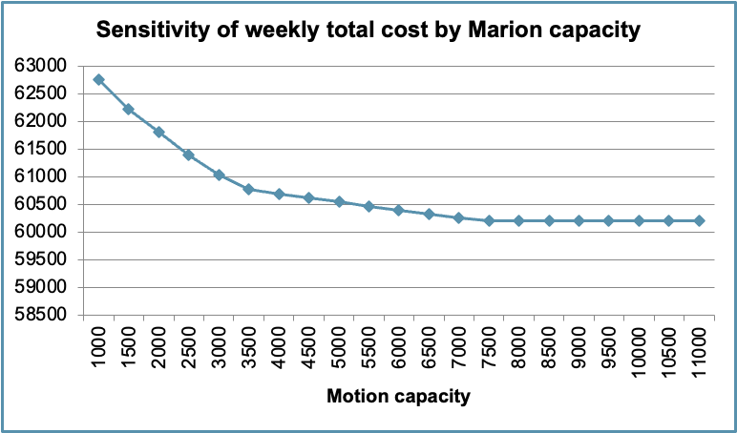
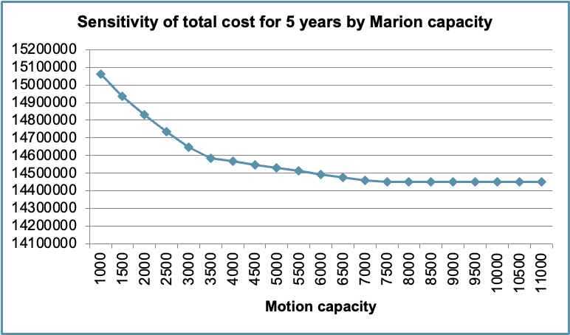
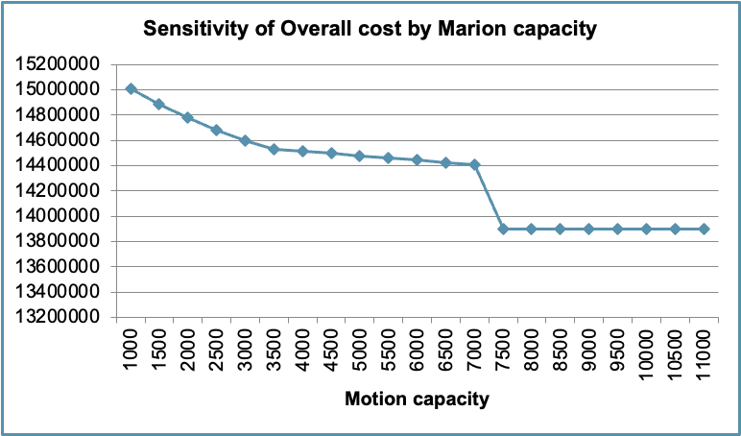
One-way Sensitivity Analysis for Scenario 7 by capacity of Marion hub

Slide 15
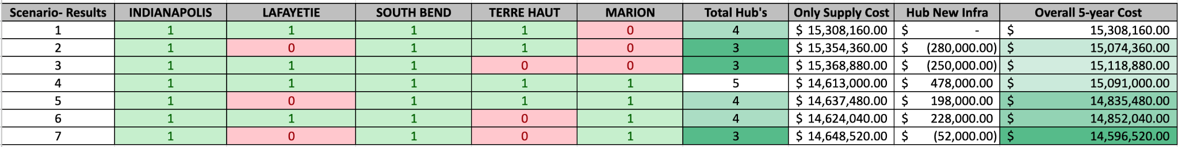
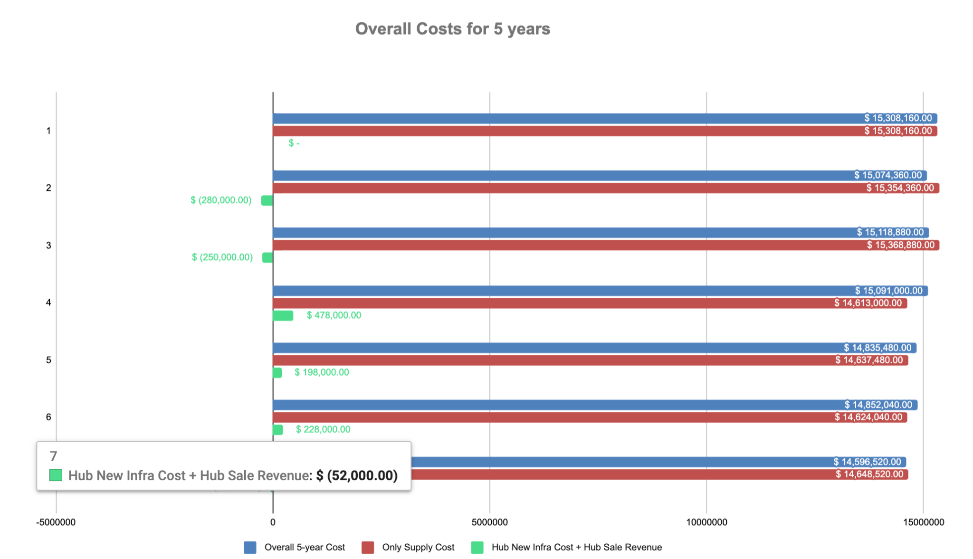
Scenarios Summary

Slide 16
Conclusion
A new building expansion dilemma
Add Marion or close one or more.
Feasible solution
Factors, Variables, Formulas
Min Weekly Cost = Transportation + service
Long-term Cost (5 years) = Sale + cost
Model Analysis for the project
LP model
One-way Sensitivity
Solution
Scenario 7 with overall lowest cost $ 14, 596, 520;
Close Lafayette & Terre haute, open Marion

Slide 17

THANK YOU FOR LISTENING

